Slide 1










Welcome to Year 6!!

Slide 2
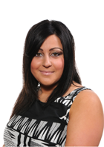
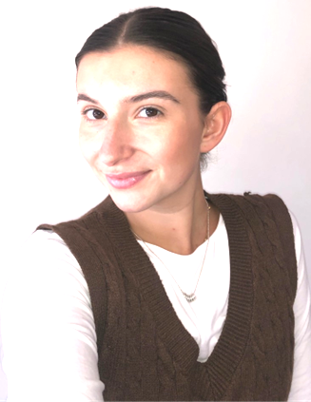
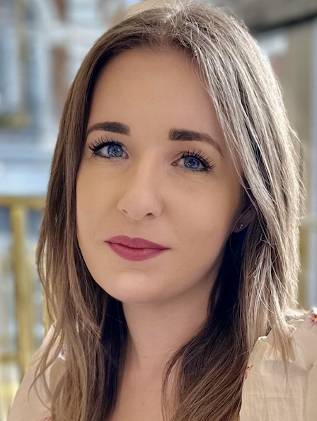
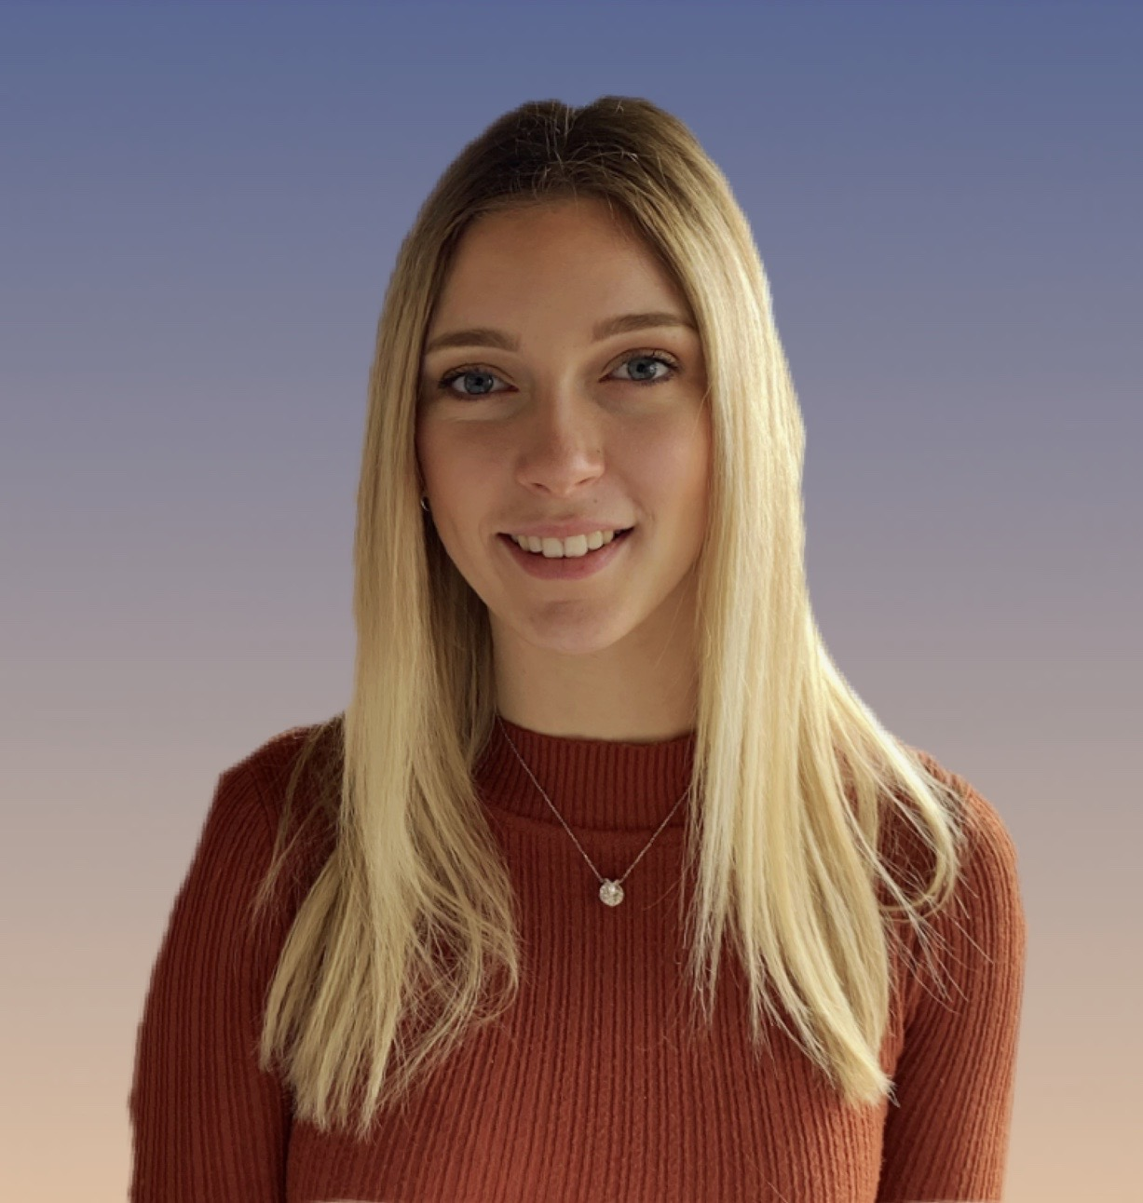
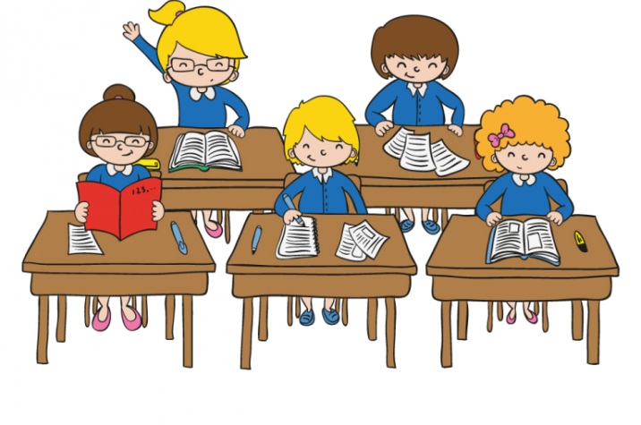

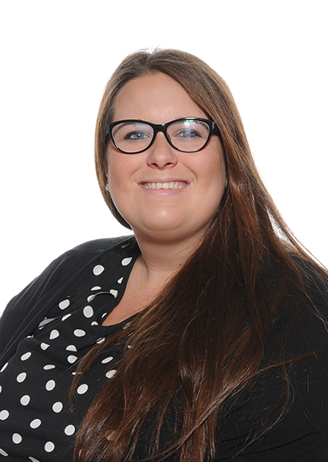
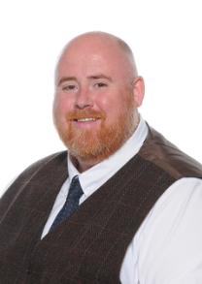
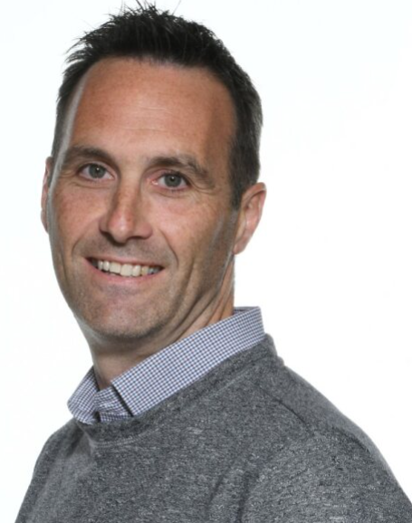
Meet the Year 6 Team
6B 6G 6R 6Y
Miss Moore
Miss Prescott
Miss Papa-Adams
Head of Year
Miss Limbert
Teaching Assistants:
Mrs Haste
Mr Richards
Mrs House
Mrs Roberts
Learning group teachers
Mr Kettle
Miss Scarr
Mr Rowe
APA

Slide 3
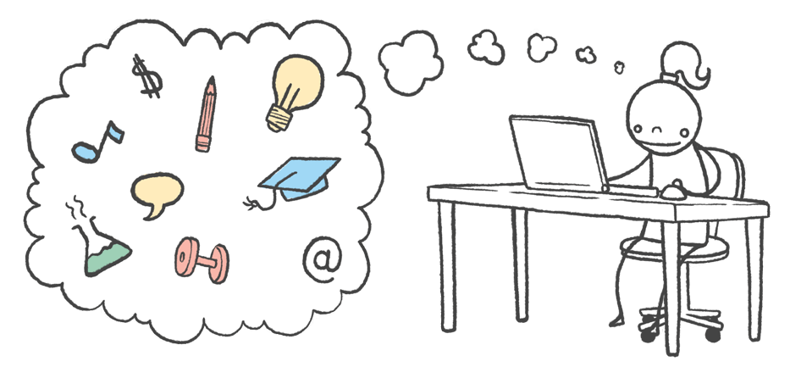




Our role is to provide the children with stimulus and skills, developing a thirst for knowledge, so that our pupils are empowered to fulfil their individual potential. Our lessons aim to be enjoyable, inclusive, engaging and link to the Core Values of our school.
Friendship Aspiration
Resilience Respect
APA

Slide 4

English
At Upton we believe that reading should truly be at the heart of the English curriculum. Pupils who read well will ultimately have greater access to our textually rich world, generating a long-lasting love of books.
Text-based Curriculum
Our Text Based Curriculum means that all reading and writing will link to a class text. Spelling, punctuation and grammar (SPAG) will be explicitly taught and skills will be fed into the writing.
Children will be exposed to a range of authors and text types. In reading, children will be focusing on inference, understanding new vocabulary and using reciprocal reading skills (predicting, summarising, questioning and clarifying) to extend and deepen understanding.
In writing, children will be immersed in different genres and styles and taught the skills to do so. Writing tasks provide opportunities to build on these skills. Pupils will also edit, improve and publish their work.
RM

Slide 5





English
Term 1: Floodland
Term 2: Highwayman
Term 3: Pig Heart Boy & Skellig
Term 4: Kensuke’s Kingdom
Term 5: Letters to the Lighthouse & Rose Blanche
Term 6: Wonder
RM

Slide 6

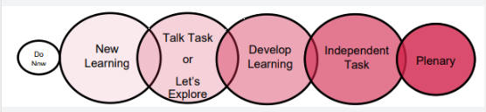

Maths
We follow the National Curriculum and the Maths Mastery Scheme of Learning. Our lessons follow a structure including Diagnostic questioning, let’s link (teacher input), partner practice, main activities with scaffolded challenges. Pupils will follow the six part lesson to become rounded mathematicians that can apply their knowledge to a variety of situations.
Pupils will also undertake frequent arithmetic activities, learn times tables and recap key fluency through their Maths Meetings.
Homework:
My Maths
Times Tables Rock Stars
Within Maths teaching and learning, the Build it, Draw it, Solve it approach encourages the use of: Concrete; Pictorial; Abstract. The intention of such a progression is to develop the concept of 'Maths Mastery' in which all children fully grasps concepts before they are moved on within the curriculum.
MP

Slide 7

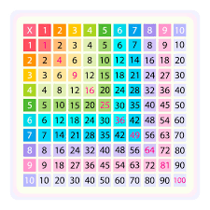

Maths
Times tables are incredibly important and we wanted to stress to you the importance of our children having sound rapid recall of their times tables up to 12.
There are multiple strategies that you could use alongside TTRS at home that would support your children in learning their times tables. Some of these strategies are: times table bingo, chanting, quick fire questions and learning rhymes.
MP

Slide 8
Upton Thematic Curriculum
Term 1: Darwin’s Delights
Term 2: My Home My Country
Term 3: How to mind your Heart
Term 4 & 5: Paths to Peace
Term 6: Light it Up
MP

Slide 9

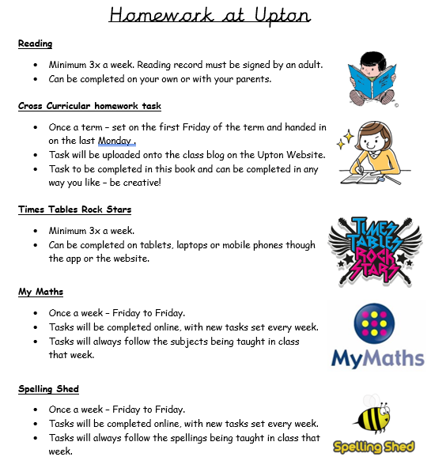

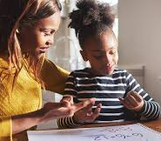
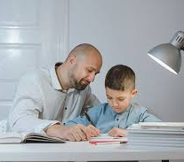

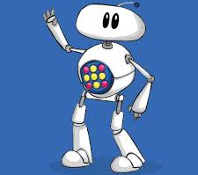







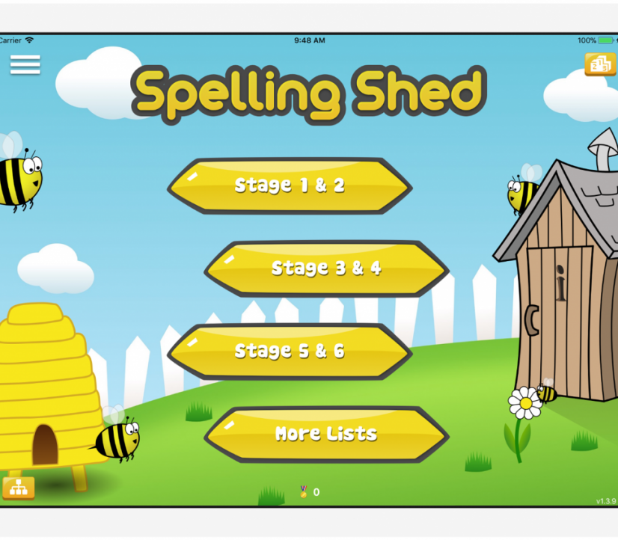

ML

Slide 10
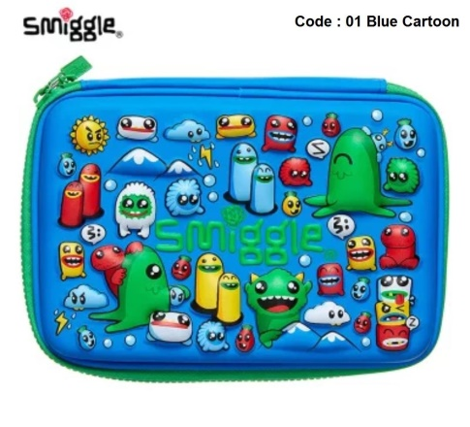
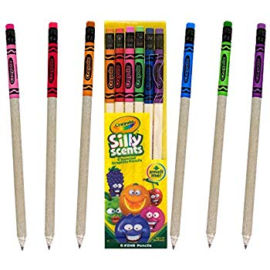

Pencil Cases
At Upton, we provide children with everything they will need for each lesson (pencils, pens, sharpeners, rubbers etc) therefore children do not need to bring in their own pencil cases.
Large pencil cases and ‘novelty’ stationary unnecessarily takes up space in trays and on desks and often creates a distraction to learning.
Lost Property
We always have well stocked lost property boxes on the playground path!
Please ensure items
are named and
updated to your
child’s class!
ML

Slide 11

P.E
Please send your child into school wearing their full PE kit, including their trainers every WEDNESDAY.
If your child cannot take part in PE for any reason we require a parental note/message left at the office. It is vital that children join in with PE.
Please ensure children have the correct pe kit in school.
Black or navy joggers/shorts
House colour Upton T shirt
Upton hoody/black/navy jumper
trainers
- Water bottles: Please ensure pupils have enough water in school to last them all day.
Term 1 FRIDAY: 6B & 6G Swimming and Music
6R & 6Y Computing and Art
School Uniform
Please ensure children are coming to school in the correct school uniform.
Children should be wearing ties,
Thye should have the correct school shoes on
Hair should be tied back
Earrings should be little studs
No nails polish on nails
ML

Slide 12


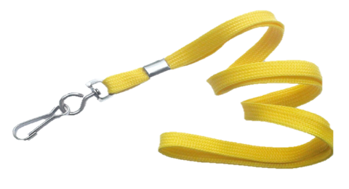
Behaviour
We are here to learn. Behaviour for Learning helps us learn.
Verbal warning – the teacher will warn the child that their behaviour is not appropriate classroom.
If they continue to misbehave – the child will be given a Yellow card. This means they will lose 1 of their behaviour points.
If they continue or the behaviour is thought to be more serious then they may receive a RED CARD. This means 2 points are taken off the total of 5.
Cards can be redeemed during the lesson if a child makes an effort to change their behaviour.
At lunchtime we have cool down benches for children to have some time out.
Cases of serious misbehaviour will be dealt with by the Year Leader or the Senior Leadership Team.
CR

Slide 13
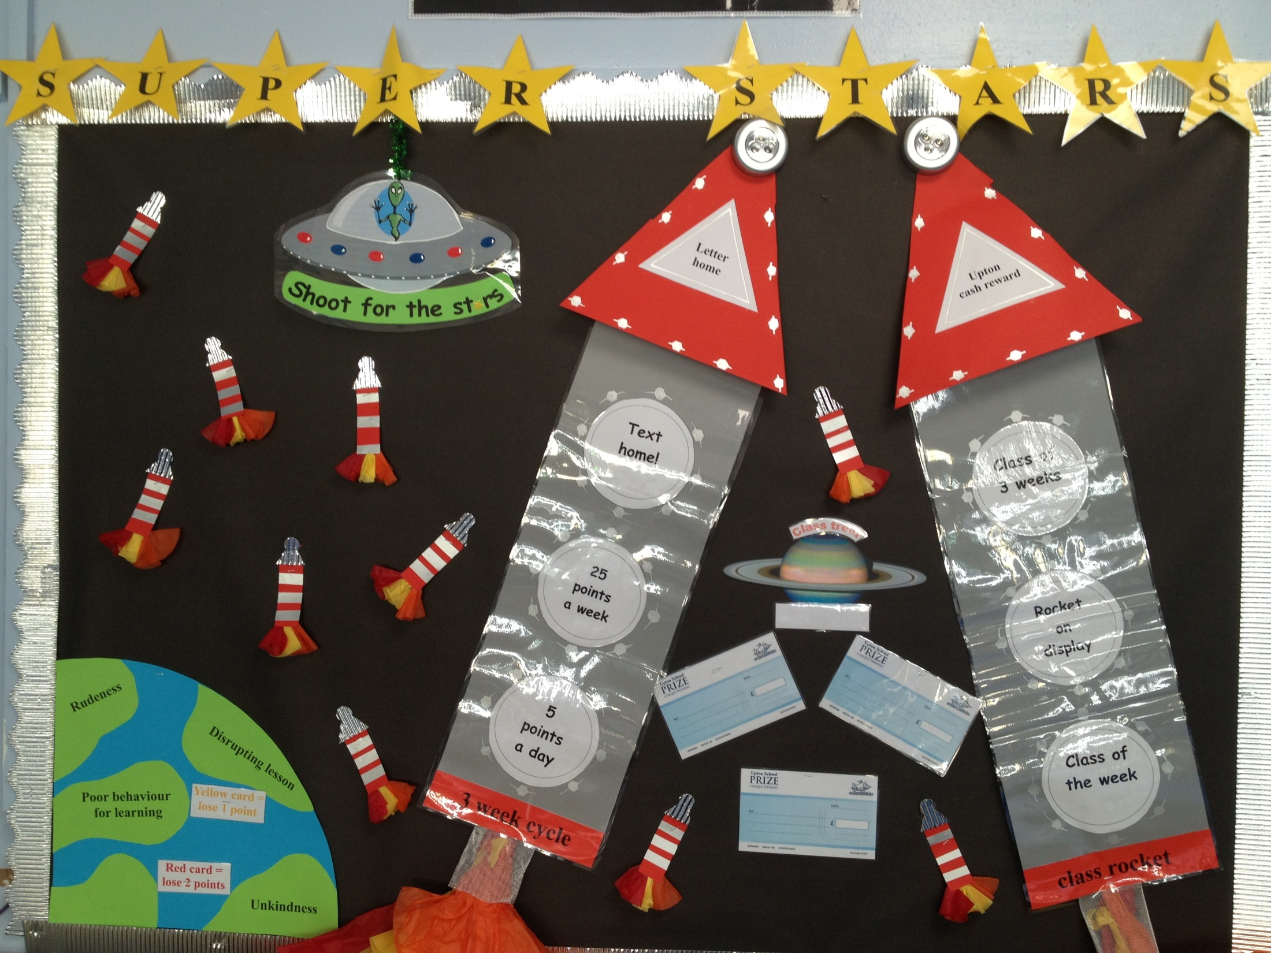
CR

Slide 14
Behaviour
Each day you will start with a maximum of 5 points.
Between Monday and Friday you can earn a maximum of 25 points.
If by Friday afternoon you have kept your 25 points then you will exchange these for PERFECT POINT FRIDAY!
Points will also then be counted after 3 weeks and we will receive rockets.
Points will be taken away for inappropriate behaviour during lessons.
If children have lost a point they will lose 2 minute for every point they have lost from their perfect point time– this means no one misses the entire treat!
CR

Slide 15



Don’t forget to check on the website for the year group blogs. We will post every Friday with key messages, let you know what we have covered across the week, inform you of upcoming learning and achievements from the week.
APA

Slide 16

Communication
Any problems OR things you think we should know that could affect your child’s education:
Letter/Note
Email
Pop in via the office
Telephone
APA

Slide 17

We are looking forward to a great final year!

