Slide 1









Welcome to Year 5!!

Slide 2

Meet the Year 5 Team
5B 5G 5R 5Y
Miss Reed and Mr Faulkner
Miss Lewis
(Head of Year)
Mrs Phillips
Miss Newman
Learning Group Teacher:
Mrs Denby
Teaching Assistants:
Mrs Shaw
Mrs Moynan
Mr Mcleod
Mrs Williams-Verrall

Slide 3




Core Values
Our role is to provide the children with stimulus and skills, developing a thirst for knowledge, so that our pupils are empowered to fulfil their individual potential. Our lessons aim to be enjoyable, inclusive, engaging and link to the Core Values of our school.
Friendship
Aspiration
Resilience
Respect

Slide 4

English
At Upton we believe that reading should truly be at the heart of the English curriculum. Pupils who read well will ultimately have greater access to our textually rich world, generating a long-lasting love of books.
Text-based Curriculum
Our Text Based Curriculum means that all reading and writing will link to a class text. Spelling, punctuation and grammar (SPAG) will be explicitly taught, and skills will be fed into the writing.
Children will be exposed to a range of authors and text types. In reading, children will be focusing on inference, understanding new vocabulary and using Reciprocal Reading skills (predicting, summarising, questioning and clarifying) to extend and deepen understanding.
In writing, children will be immersed in different genres and styles and taught the skills to do so. Writing tasks provide opportunities to build on these skills. Pupils will also edit, improve and publish their work.

Slide 5







English
Term 1: There’s a Boy in the Girls’ Bathroom
& The Lady of Shalott
Term 2: Cosmic
Term 3: Anglo-Saxon Boy
Term 4: The Firework Maker’s
Daughter
Term 5: Street Child
Term 6: When the Mountains Roared

Slide 6

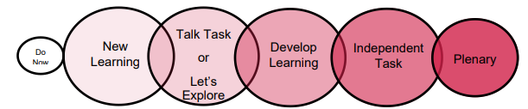
Maths
We follow the National Curriculum and the Ark Maths Mastery Scheme of Learning. Our lessons follow a set structure:
The children will also have daily Maths Meetings where they will become fluent in the fundamentals as well as address misconceptions in previously taught concepts.
Homework:
My Maths – weekly (Friday-Friday)
Times Tables Rock Stars (3 times per week)
The Ark Maths Mastery Curriculum encourages the use of manipulatives and promotes the ‘Concrete; Pictorial; Abstract’ progression. The intention of such a progression is to develop the concept of 'Maths Mastery' in which all children fully grasp concepts within the curriculum.

Slide 7

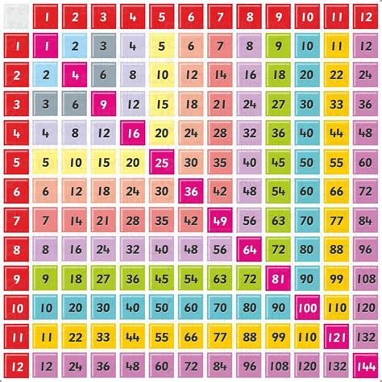

Maths
Times tables are incredibly important and we wanted to stress to you the importance of our children having sound rapid recall of their times tables up to 12x12.
There are multiple strategies that you could use alongside TTRS at home that would support your children in learning their times tables. Some of these strategies are: times table bingo, chanting, quick fire questions and learning rhymes.

Slide 8
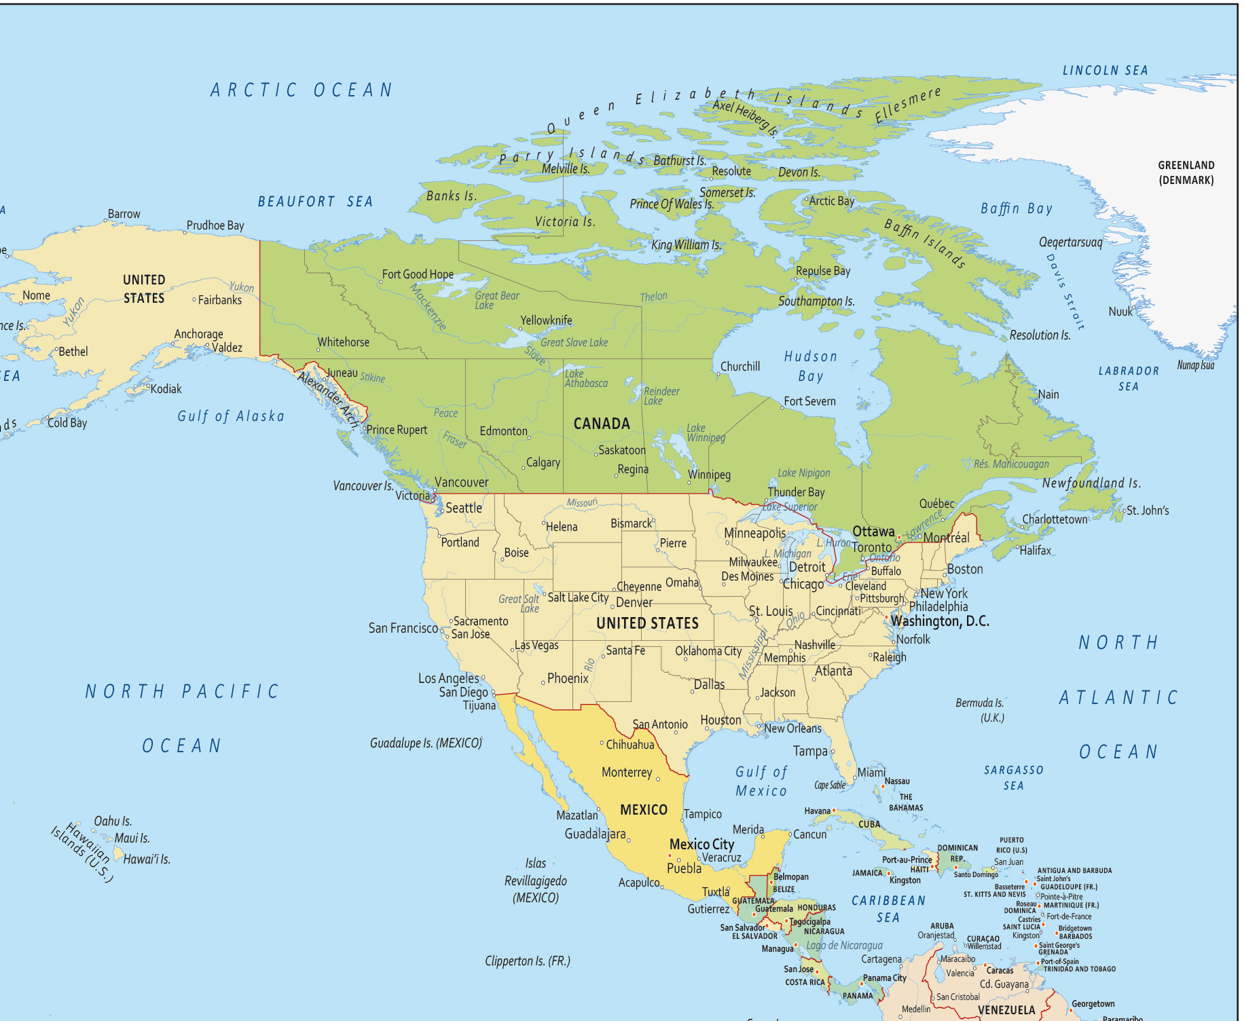
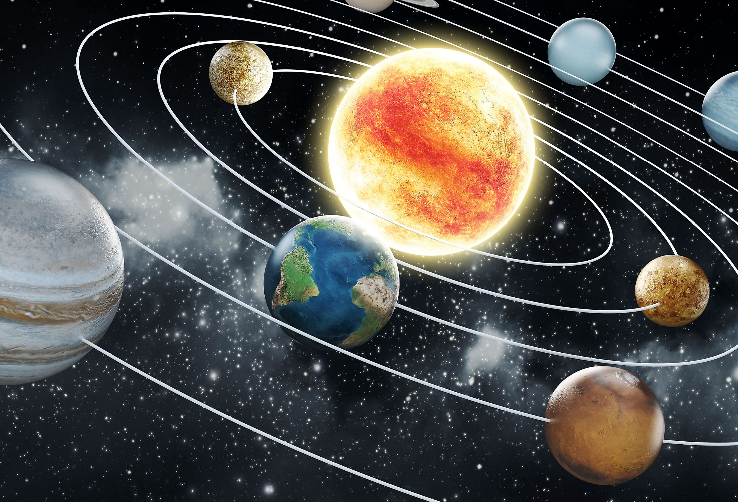
Thematic Curriculum
Term 1: Across the Pond
Term 2: Stargazers
Term 3: Marvels of Matter
Term 4: Gods and Mortals
Terms 5&6: Tides of Change

Slide 9
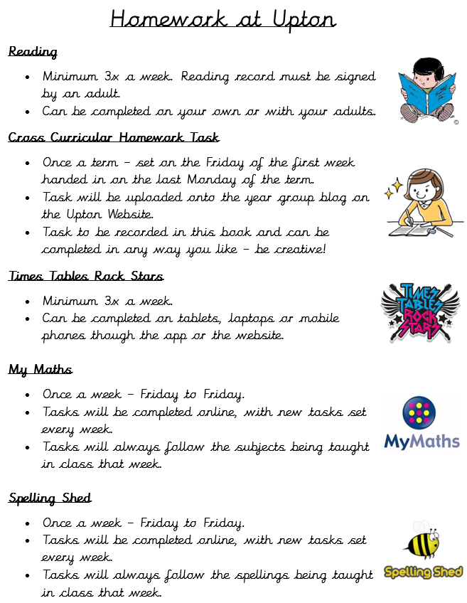

Slide 10

Pencil Cases
At Upton, we provide children with everything they will need for each lesson (pencils, pens, sharpeners, rubbers etc) therefore children do not need to bring in their own pencil cases.
Large pencil cases and ‘novelty’ stationary unnecessarily takes up space in trays and on desks and often creates a distraction to learning.
Lost Property
We always have well stocked lost property boxes on the playground path!
Please ensure items
are named and
updated to your
child’s class!

Slide 11
P.E.
Please send your child into school wearing their full PE kit, including their trainers every MONDAY.
If your child cannot take part in PE for any reason, we require a parental note/message left at the office. It is vital that children join in with PE.
Please ensure children have the correct PE kit in school.
Black or navy joggers/shorts
House colour Upton T-shirt
Upton hoody/ black or navy jumper
Trainers
Water bottles: Please ensure pupils have a refillable water bottle, preferably with a sports cap, in school every day.
Term 1: 5B&5G - Swimming and Music
5R&5Y - Computing and Art

Slide 12

School Uniform
Please ensure children are coming to school in the correct school uniform.
Children should be wearing ties
Hair should be tied back if touches shoulders
Earrings should be one pair of small studs
No nail polish on nails
Coat or jacket for school | Navy blue, grey or black preferred
V-neck jumper or cardigan | Navy blue v-neck jumper or cardigan. Branded items available from the Schoolwear Centre
Skirt/ pinafore | Dark grey
Summer dresses | Any suitable material in blue and white, in a design appropriate to school wear i.e. checks
Trousers/shorts | Dark grey. Tailored shorts only.
Shirts / Blouse | White. No polo t-shirts.
Blazer* | *Optional Navy blazer* available from the Schoolwear Centre.
Tie | Navy tie with house coloured logo. Available from the Schoolwear Centre.
Shoes | Black, flat heels. (No boots, trainers or sandals)
Socks or tights | Navy, black, grey or white only

Slide 13


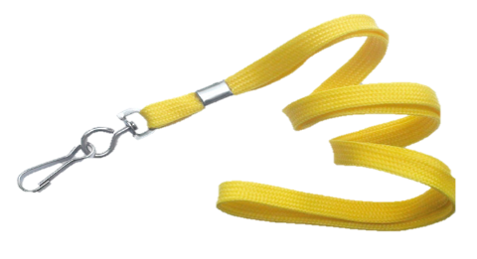
Behaviour
We are here to learn. Behaviour for Learning helps us learn.
Verbal warning – the teacher will warn the child that their behaviour is not appropriate.
If they continue to misbehave, the child will be given a Yellow card. This means they will lose 1 of their behaviour points.
If they continue or the behaviour is thought to be more serious, they may receive a RED CARD. This means 2 points are taken off the total of 5.
Cards can be redeemed during the lesson if a child makes an effort to change their behaviour.
At lunchtime, we have cool down benches for children to have some time out.
Cases of serious misbehaviour will be dealt with by the Year Leader or the Senior Leadership Team.

Slide 14

Behaviour
Each day you will start with a maximum of 5 points.
Between Monday and Friday, you can earn a maximum of 25 points.
If by Friday afternoon, if you have kept your 25 points then you will exchange these for PERFECT POINT FRIDAY!
Points will also then be counted after 3 weeks and we will receive rockets.
Classes will work towards a treat of their choice termly.
Points will be taken away for inappropriate behaviour during lessons.
If children have lost a point, they will lose 2 minutes for every point they have lost from their termly treat – this means no one misses the entire treat!

Slide 15




Don’t forget to check on the website for the year group blogs. We will post every Friday with key messages, let you know what we have covered across the week, inform you of upcoming learning, provide homework and celebrate achievements.

Slide 16
Communication
Any problems OR things you think we should know that could affect your child’s education, please let us know:
Letter/Note
Email
Pop in via the office
Telephone
5B: isobel.reed@uptonjunior.com and sam.faulkner@uptonjunior.com
5G: nikki.lewis@uptonjunior.com
5R: natalie.phillips@uptonjunior.com
5Y: leanne.newman@uptonjunior.com
LG: michelle.denby@uptonjunior.com

Slide 17

We are looking forward to a FABULOUS year!
Thank you for coming to the Year 5 Meet and Greet.

