Slide 1


Welcome to
Upton Junior School
Admission to Secondary School in Kent

Slide 2

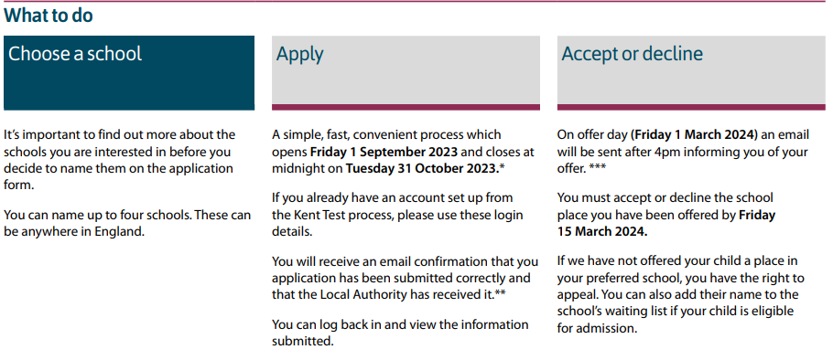
School Application
Go to Kent Online Admissions kent.gov.uk/secondaryadmissions Apply online for a Secondary school place in Kent.
Opens Friday 1st September 2023 and closes at midnight on Tuesday 31st October 2023

Slide 3


Key Dates
Friday 1st September 2023 | Online application process opens. Go to www.kent.gov.uk/ola to register and apply. Information about secondary schools will be available from our website. School open evenings begin, and details can be found on each school’s website.
By Wednesday 18th October 2023 | Kent Test (11+) assessment decisions sent to parents after 4pm.
Tuesday 31st October 2023 | Online application process closes for the main round. Any amendments after this date must be emailed to kentonlineadmissions@kent.gov.uk
Friday 1st March 2024 | Offers of school places sent to parents via email after 4pm.
By Friday 15th March 2024 | Parents should contact the school to accept/refuse the place that has been offered. Parents should also fill out the waiting list form from the link in the offer email to be added to the waiting list of schools named on the original application.

Slide 4


Key Dates
By Thursday 28th March 2024 | Appeals need to be lodged by this date to be heard before September – appeals information can be found at www.kent.gov.uk/schoolappeals You can only appeal for schools that were named on the SCAF.
By Thursday 25th April 2024 | Offer day for the second round of applications (known as reallocation). After this date waiting lists will be maintained by the schools and they will send out offers for any places that may become available. Parents that have received an offer of a school place from KCC can approach schools directly for alternative places.
April to June 2024 | Admission appeals held.

Slide 5

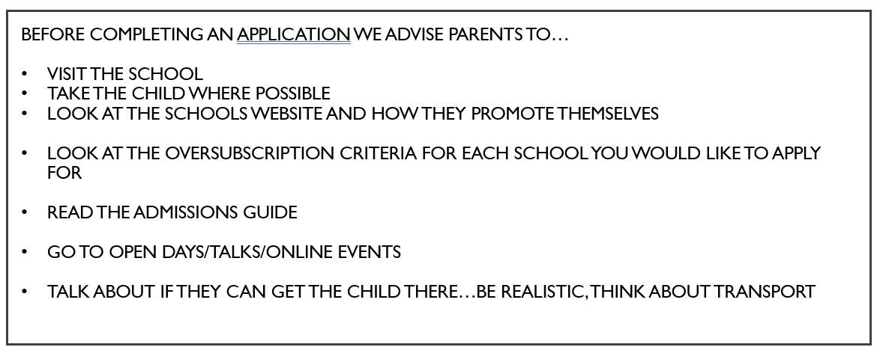

Slide 6


Application
You need to apply for year 7 Secondary school places for September 2024 by Tuesday 31 October 2023.
When you know which schools you are interested in, you need to apply either using the online process available at www.kent.gov.uk/secondaryadmissions or via an alternative method obtained by emailing kentonlineadmissions@kent.gov.uk.
You should complete the application by naming up to four schools; putting them in order of preference with the one you would like most first.

Slide 7

Schools of Interest
Schools publish a lot of information about what they teach, the facilities they offer and what they aim to achieve for their pupils on their websites. They will also have their own prospectus or booklet which you can ask for if you are interested in the school.
All schools hold open days and evenings, when parents and children can visit and talk to teachers and existing pupils. We believe this provides a very good opportunity for you to get the feel of the school and encourage you to use the opportunities available.
Headteachers welcome enquiries from parents and will be able to tell you a great deal about their schools. Please see school websites for information about when these open evenings will take place.

Slide 8

Decisions
How are decisions made?
The assessment decision is based on the test results. However, before you receive your decision, your child’s Primary school Headteacher will have the opportunity to refer assessment decisions they disagree with to a panel of local Primary and Secondary school Headteachers, who will consider additional evidence before making a decision.
This can include your child’s test scores, recent work, the writing task and comments from your child’s current school. The panel will look at a full range of work for a child, regardless of which scores may be below the threshold. To allow these referrals to take place, your child’s Primary school will be sent your child’s score and assessment decision.
An assessment will only be changed by the Headteacher Assessment Panel if the panel is confident that the child will be well placed in a Grammar school.
The assessment decision will be sent to you by Wednesday 18 October 2023. Results will be sent by email after 4pm to parents who applied providing an email address, and letters will be posted first class to all other parents. Online applicants can view their child’s assessment and test scores after 5pm on results day by logging back into their online application.

Slide 9

How do I apply for a Secondary school place?
If you live in the Kent Local Authority area, and you would like your child to start at ANY Secondary school in September 2024 you MUST complete the Kent Secondary Common Application Form (SCAF), either online, through the Kent website www.kent.gov.uk/secondaryadmissions, or by contacting the team on kentonlineadmissions@kent.gov.uk for an alternative method.
If you already registered your child online to take part in the Kent Grammar school tests, you will be able to log in to your account and add your school preferences to the information you have already submitted rather than starting from the beginning. Please ensure that all the information on the application is accurate before it is submitted.
If you are applying online for school places and did not register your child for the Kent Test, you will have to register with the website and create a user account, selecting your own password. The website will ask you to verify your account by clicking on the link provided in the email sent to the email address used to set up the account. This email is not an application. Once registered, you can then make an application for school places either straight away or by logging back in at a later time, provided it is before the closing date. An application is only valid if it has been submitted by the closing date (Tuesday 31 October 2023).

Slide 10
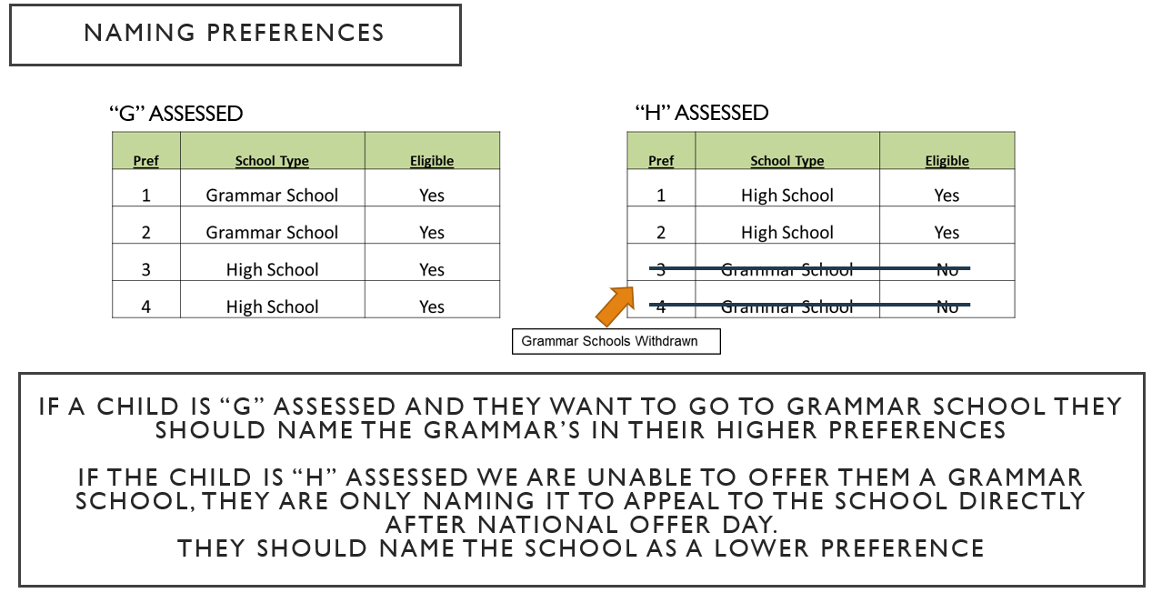

Summary of School Choices
4 choices
Put them in order of preference – if two schools can offer a place, the school highest on your list will be offered.
You must look at each school’s admissions criteria if unsure of which to put and what needs to be included (Church Schools).
If you are unsure whether you are within the correct distance from a secondary school, look at the over-subscription criteria.
You can give reasons for each preference including details of any siblings that will still be on roll at the preferred school at the time of the applicant child’s admission.

Slide 11
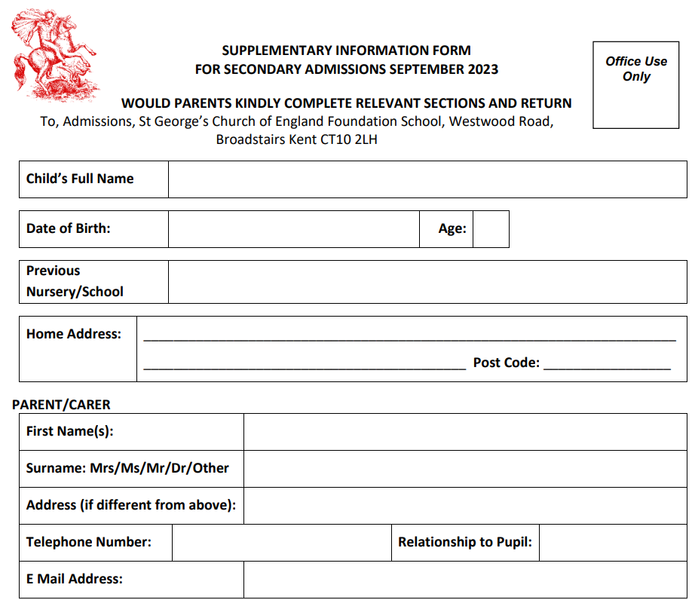
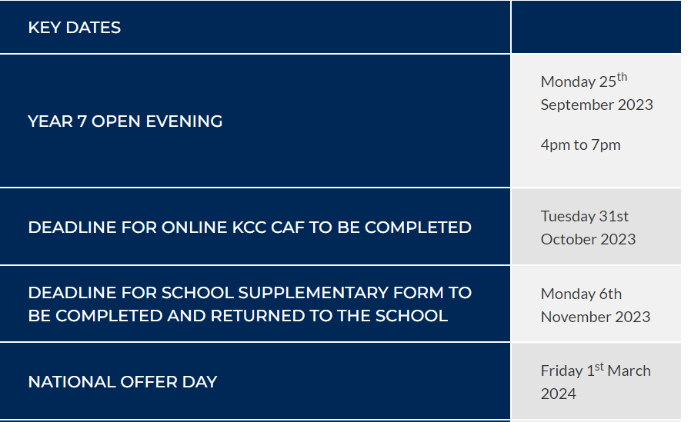
ST George’s Key Information
IT IS ESSENTIAL THAT PARENTS COMPLETE THE SCHOOL’S OWN SUPPLEMENTARY INFORMATION FORMS IF THEY WISH THEIR CHILD TO BE CONSIDERED BY ST. GEORGE’S COF E FOUNDATION SCHOOL.
This form can be downloaded from the school website under ADMISSIONS

Slide 12
What happens after I’ve received an offer?
On Friday 1st March 2024 KCC will contact Kent parents to inform them of the school they have been offered. You will receive only ONE offer. E-mail messages will be sent after 4pm to parents who provided an email address on their application, and letters will be posted first class to all other parents. Please be aware that KCC has no control over email delivery times once they have left their servers and some email providers may delay sending the messages to account holders. Parents are also advised to check their spam mail folders for the email before contacting kentonlineadmissions@kent.gov.uk.
All online applicants can also log back on to their online applications after 5pm and view their school offer. The applying parent must let the offered school know whether you are accepting or refusing the place by Friday 15th March 2024. If you do not let the school know that you are accepting the place, it may be offered to someone else and you will lose it.

Slide 13
What happens after I’ve received an offer?
IMPORTANT: PLEASE ensure that you carefully read all of the email/letter as they will provide you with additional information on what to do next. It will provide you with an opportunity to either accept or refuse the place offered to you, how to request that your child’s name is placed on the waiting list for any school you named on your SCAF but were not offered, and it will provide information on how to appeal against the decision to refuse your child a place at the school.

Slide 14

Appealing school choice
What if I disagree with the assessment decision?
You cannot make an appeal against the assessment decision sent to you in October, but you are still allowed by law to appeal for admission to any school you name on your SCAF and are not offered. If your child has not been assessed suitable for Grammar school but you name a Grammar school anywhere on your SCAF, you can ask an independent panel to consider whether there could be an exceptional reason for admitting your child to that school. Appeals for admission to Kent schools should be lodged by Thursday 28 March 2024. The information which comes with your offer of a school place will explain how to do this.

Slide 15

How do I join a schools waiting list?
If a school is full the admission authority for that school must keep a waiting list, at least until the start of the January term 2025. A Grammar school can only put children on its waiting list who have been assessed suitable for Grammar school.
On Thursday 25th April 2024 the Council will run a reallocation process to offer any vacant places to children on schools’ waiting lists. Reallocation works in the same way as the process which offered places on Friday 1 March 2024, so that any places which may have become available can be offered to children on waiting lists, ranked by the schools according to their original oversubscription criteria. If more than one of the schools a parent would like can offer a place, they will offer the one they ranked highest on their waiting list form.
After Thursday 25 April 2024 schools will use their waiting lists to allocate any vacant places as they arise. The names on a school’s waiting list must be ranked according to its published oversubscription criteria.

Slide 16


Slide 17

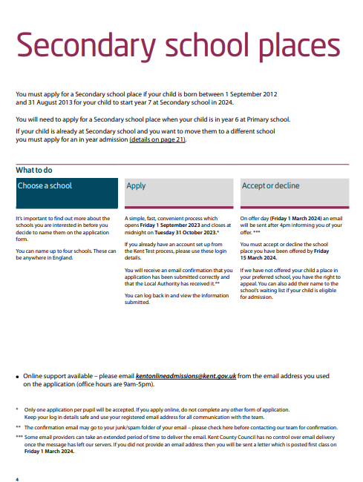
Websites
https://www.kent.gov.uk/__data/assets/pdf_file/0005/125456/Secondary-admissions-book.pdf
https://www.kent.gov.uk/education-and-children/schools/school-places/secondary-school-places

