Slide 1






Welcome to Year 4!!
HAPPY
SAFE
SUCCESSFUL

Slide 2


Meet the Year 4 Team
4B 4G 4R 4Y
Mrs Phillips
Miss Lewis (Head of Year 4)
Miss Watkins
Miss Sinstadt
Learning Group Teacher:
Mr Mason
Teaching Assistants:
Mrs Buckley – 4B
Mr McCollum - 4G
Mrs Berry – 4R
Miss House - 4Y
Mrs Wei - LG

Slide 3




Core Values
Our role is to provide the children with stimulus and skills, developing a thirst for knowledge, so that our pupils are empowered to fulfil their individual potential. Our lessons aim to be enjoyable, inclusive, engaging and link to the Core Values of our school.
Friendship
Aspiration
Resilience
Respect

Slide 4

English
At Upton we believe that reading should truly be at the heart of the English curriculum. Pupils who read well will ultimately have greater access to our textually rich world, generating a long-lasting love of books.
Text-based Curriculum
Our Text Based Curriculum means that all reading and writing will link to a class text. Spelling, punctuation and grammar (SPaG) will be explicitly taught, and skills will be fed into the writing.
Children will be exposed to a range of authors and text types. In reading, children will be focusing on inference, understanding new vocabulary and using Reciprocal Reading skills (predicting, summarising, questioning and clarifying) to extend and deepen understanding.
In writing, children will be immersed in different genres and styles and taught the skills to do so. Writing tasks provide opportunities to build on these skills. Pupils will also edit and improve their work.

Slide 5








English
Term 1: Gregory Cool &
Leon and the Place Between
Term 2: The Egyptian Cinderella &
Marcy and the Riddle of the Sphinx
Term 3: I survived the Eruption of Mount St. Helens
Term 4: The Miraculous Journey of Edward Tulane
Term 5: Song of the Dolphin Boy
Term 6: The Boy at the Back of the Class

Slide 6

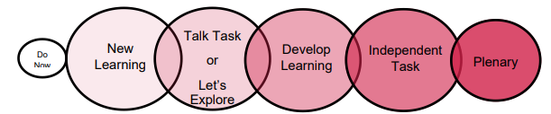
Maths
We follow the National Curriculum and the Ark Maths Mastery Scheme of Learning. Our lessons follow a set structure:
The children will also have daily Maths Meetings where they will become fluent in the fundamentals as well as address misconceptions in previously taught concepts.
Homework:
Mathletics – weekly (Friday-Friday)
Times Tables Rock Stars (at least 3 times per week)
The Ark Maths Mastery Curriculum encourages the use of manipulatives and promotes the ‘Concrete; Pictorial; Abstract’ progression. The intention of such a progression is to develop the concept of 'Maths Mastery' in which all children fully grasp concepts within the curriculum.

Slide 7

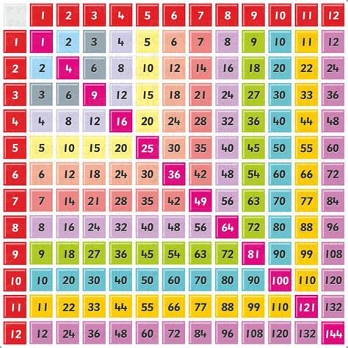

Maths
Times tables are incredibly important, and we wanted to stress to you the importance of our children having sound rapid recall of their times tables up to 12x12.
Towards the end of the year, all Year 4 children will complete a times tables check – set by the government.
There are multiple strategies that you could use alongside TTRS at home that would support your children in learning their times tables. Some of these strategies are times table bingo, chanting, quick fire questions and learning rhymes.

Slide 8
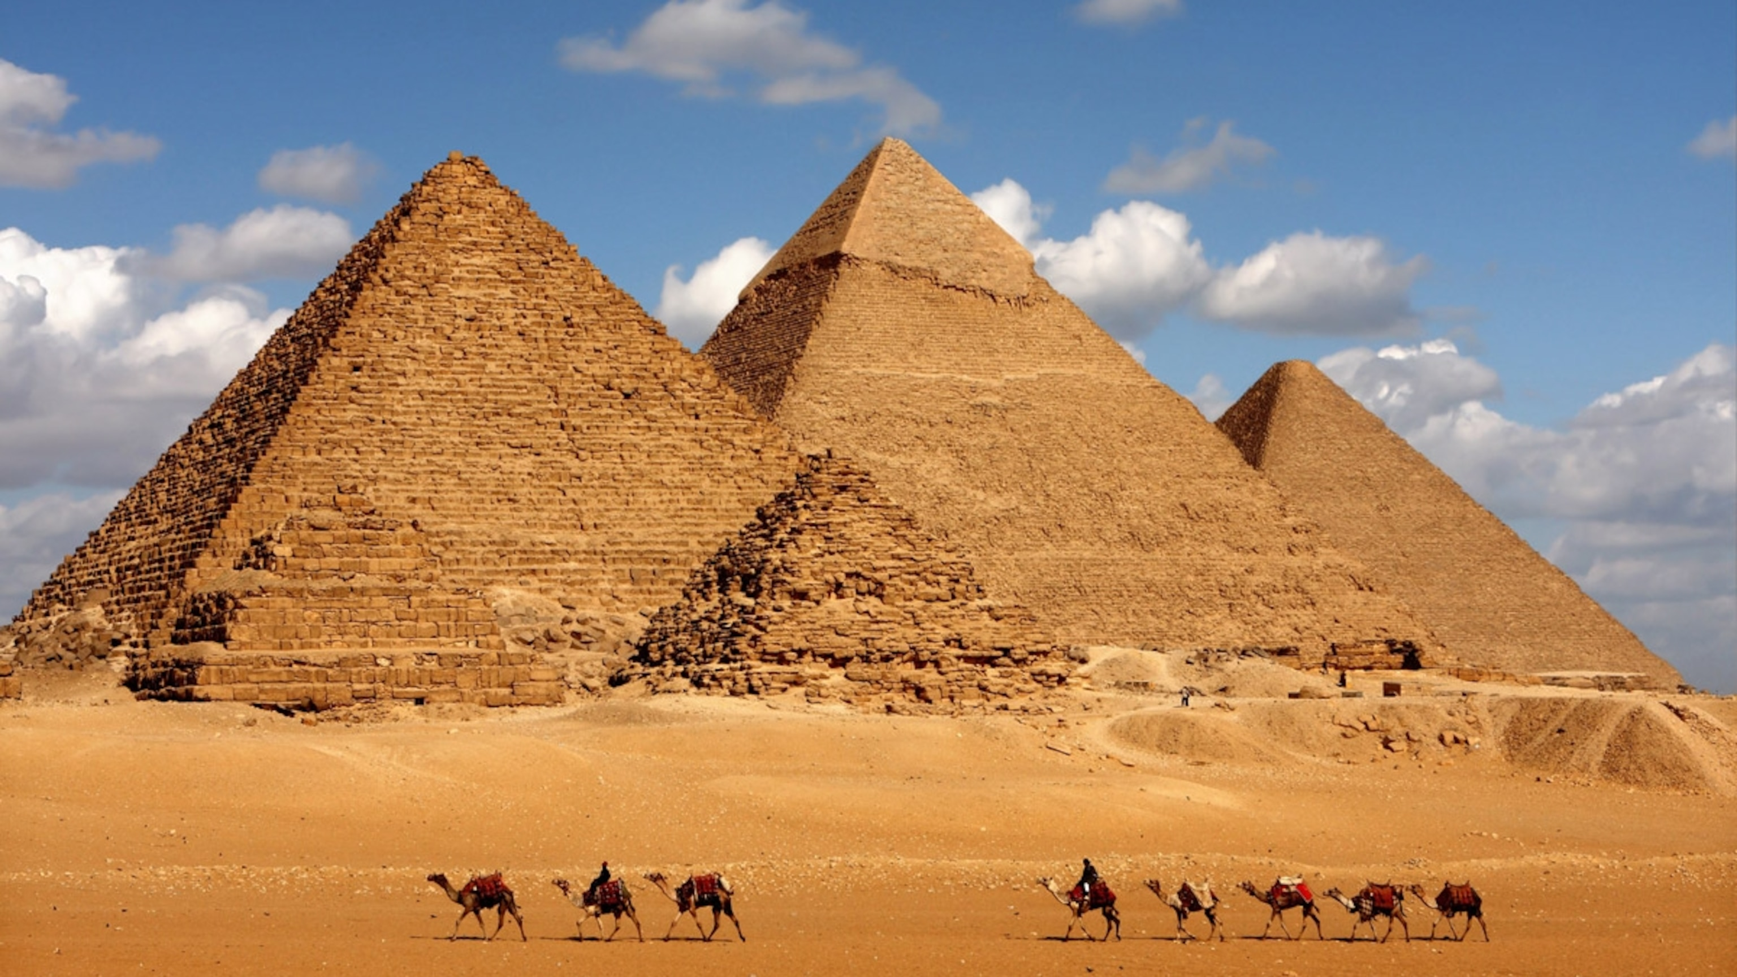

Thematic Curriculum
Term 1: Make Some Noise
Term 2: Walk Like an Egyptian
Term 3: Cracking the Earth’s Core
Term 4: Innovation Station
Term 5: Water World
Term 6: My Home is Your Home

Slide 9
Homework at Upton
Reading
This should be completed daily.
Reading records should be brought in every day and signed by an adult.
Spelling
Look, Say, Cover, Write, Check for the Year 3/4 words or words chosen by the teacher. 5 words per week.
TTRS
Aim to complete this at least 3 times a week for 10 minutes at a time.
Certificates and achievement stars will be given out regularly.
Mathletics
This will be set on a Friday.
Tasks will normally follow the concepts being taught that week in class.
Certificates will be given out once achieved. 1000 points are needed per certificate.
AR Quizzes
To be completed on Accelerated Reader once a book has been finished.
Please use the link provided in the letter sent via MCAS
*Please note, Mathletics has a different login to AR and TTRS.*
Thematic
Please choose 1 piece to complete from the grid. This is to be completed across the term and brought in. You can complete as many as you wish across the term.

Slide 10

Pencil Cases and Toys
At Upton, we provide children with everything they will need for each lesson (pencils, pens, sharpeners, rubbers etc) therefore children do not need to bring in their own pencil cases.
Large pencil cases and ‘novelty’ stationary unnecessarily takes up space in trays and on desks and often creates a distraction to learning.
Toys should not be brought in from home.
Lost Property
We always have well stocked lost property boxes on the playground path!
Please ensure items are named and updated to your
child’s class!

Slide 11
P.E.
Please send your child into school wearing their full PE kit, including their trainers every MONDAY.
If your child cannot take part in PE for any reason, we require a parental note/message left at the office or with the class teacher. It is vital that children join in with PE.
Please ensure children have the correct PE kit in school.
Black or navy joggers/shorts
House colour Upton T-shirt
Upton hoody/ black or navy jumper
Trainers
Children MUST have a swimming cap and earrings removed.
Term 1:
4B&4G - Swimming and Music
4R&4Y - Computing and Art
Water bottles: Please ensure children have a refillable water bottle, preferably with a sports cap, in school every day.

Slide 12

Forest School
We are excited to introduce Forest School this year. Sessions will take place on a Friday afternoon and will happen on a rotational basis.
Children MUST have wellies to access the environmental area.
Children can spend time in the environmental area during lunchtimes, but they MUST wear their wellies
Thrive
Across the school, we follow the Thrive approach, which is an evidence-informed, developmental and trauma-sensitive approach to meeting the emotional and social needs of children.
Children will be completing Thrive activities in class at least 2 times per week.

Slide 13

School Uniform
Please ensure children are coming to school in the correct school uniform.
Children should be wearing ties
Hair should be tied back if it touches shoulders
Earrings should be one pair of small studs
No nail polish or jewellery
Coat or jacket for school | Navy blue, grey or black preferred
V-neck jumper or cardigan | Navy blue v-neck jumper or cardigan. Branded items available from the Schoolwear Centre
Skirt/ pinafore | Dark grey
Summer dresses | Any suitable material in blue and white, in a design appropriate to school wear i.e. checks
Trousers/shorts | Dark grey. Tailored shorts only.
Shirts / Blouse | White. No polo t-shirts.
Blazer* | *Optional Navy blazer* available from the Schoolwear Centre.
Tie | Navy tie with house coloured logo. Available from the Schoolwear Centre.
Shoes | Black, flat heels. (No boots, trainers or sandals)
Socks or tights | Navy, black, grey or white only

Slide 14


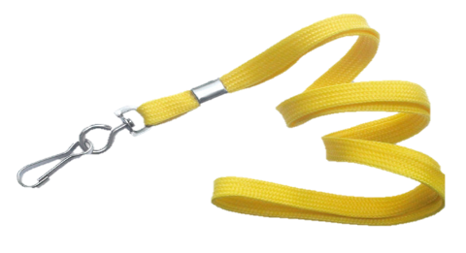
Behaviour
We are here to learn. Behaviour for Learning helps us learn.
Verbal warning – the teacher will warn the child that their behaviour is not appropriate.
If they continue to misbehave, the child will be given a Yellow card. This means they will lose 1 of their behaviour points.
If they continue or the behaviour is thought to be more serious, they may receive a RED CARD. This means 2 points are taken off the total of 5. A phone call home will be made.
Cards can be redeemed during the lesson if a child makes an effort to change their behaviour.
At lunchtime, we have cool down benches for children to have some time out.
Cases of serious misbehaviour will be dealt with by the Head of Year or the Senior Leadership Team.

Slide 15

Behaviour
Each day your child will start with a maximum of 5 points.
Between Monday and Friday, they can earn a maximum of 25 points.
If by Friday afternoon they have kept all their 25 points, then they will exchange these for PERFECT POINT FRIDAY!
Points will also be counted after 3 weeks, and we will receive rockets.
Classes will work towards a treat of their choice once they have reached 10 rockets.
Points will be taken away for inappropriate behaviour during lessons.

Slide 16




Don’t forget to check on the website for the year group blogs. We will post every Friday with key messages, let you know what we have covered across the week, inform you of upcoming learning, provide homework and celebrate achievements.

Slide 17
Communication
Any problems OR things you think we should know that could affect your child’s education, please let us know:
Letter/Note
Email
Pop in via the office
Telephone
4B: natalie.phillips@uptonjunior.com
4G and HoY: nikki.lewis@uptonjunior.com
4R: emily.watkins@uptonjunior.com
4Y: claire.sinstadt@uptonjunior.com
LG: sean.mason@uptonjunior.com

Slide 18

We are looking forward to a FABULOUS year!
Thank you for coming to the Year 4 Meet and Greet.

